Slide 1
Employee Data Analysis using Excel
STUDENT NAME:Nandhini.p
REGISTER NO:312217731nandhiniprakash6379@gmail.com
DEPARTMENT:Bcom general
COLLEGE Government arts and science college

Slide 2
PROJECT TITLE
Employee Performance Analysis using Excel

Slide 3


AGENDA
Problem Statement
Project Overview
End Users
Our Solution and Proposition
Dataset Description
Modelling Approach
Results and Discussion
Conclusion
3/21/2024 Annual Review

Slide 4

PROBLEM STATEMENT
Employee Performance Analysis Employee performance analysis is a systematic process used to evaluate individual and team contributions to organizational goals. It helps identify strengths, areas for improvement, and strategies to enhance overall productivity. Here’s an overview of the key components involved:

Slide 5

PROJECT OVERVIEW
Employee data analysis involves collecting and analyzing various data points related to employees to gain insights into workforce performance, satisfaction, and overall effectiveness. Here’s a breakdown of key aspects:
1. Data Collection
Demographic Data: Age, gender, education, tenure, etc.
Performance Data: KPIs, project completion rates, quality of work, etc.
Engagement Surveys: Employee satisfaction, motivation, and feedback.
Attendance Records: Absenteeism, tardiness, leave patterns.

Slide 6

WHO ARE THE END USERS?
HR professional
Manager and team leader
Employee
Executive and leadership team
Training and development team

Slide 7

OUR SOLUTION AND ITS VALUE PROPOSITION
Conditional formatting - missing
Filter - remove
Formula - performance
Pivot - summary
Graph - data visualization

Slide 8
Dataset Description
Employee - kaggle
26 - feature
9 feature
Employee id number
Employee type
Name text
Performance level
Gender male female
Employee rating number

Slide 9

THE "WOW" IN OUR SOLUTION
Performance level=ifs(28>=5,"very
High",28>=4,"high," 28>=3,"med," true ," low )
3/21/2024 Annual Review
9

Slide 10
MODELLING
Data collection
1.
2.
Feature collection
1.
2.
Data cleaning
1.
2.
Summary 1.
2.
Visualization
1.
2.
10

Slide 11
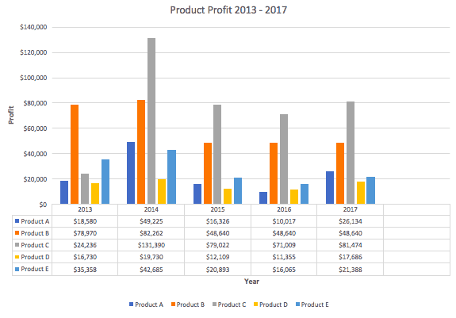
RESULTS
11

Slide 12
conclusion
Conclusion 1. Key Findings: Summarized insights and trends identified throughout the project. Highlighted successes and areas for improvement. 2. Impact: Discussed how the project outcomes align with organizational goals. Emphasized benefits to stakeholders and end users. 3. Recommendations: Proposed actionable next steps based on analysis. Suggested areas for further research or exploration.

